Slide 1
High-Performance Computing (HPC) in Azure
Microsoft Research
Notes:
Big data requires big computing power. As data proliferates from social-networking services, IoT devices, mobile phones, point-of-sale terminals, genomics studies, and other sources, the demand for computing resources to handle that data and extract meaning from it grows, too. In the old days, getting access to a Cray or a high-performance compute cluster required a government clearance or access to some of the world’s most famous institutions.
The cloud changes that by bringing the power of HPC to the masses. With a few button clicks, you can deploy a cluster of virtual machines, or VMs, to the cloud and then utilize it the same way you would a physical cluster. Recently, Microsoft partnered with a U.S. firm to deploy a cluster containing more than 100,000 cores to the cloud and then used it to perform the largest risk analysis ever performed. On a single core, the job would have taken almost 20 years. With 100,000 cores, it ran from start to finish in 90 minutes. This is how the cloud is changing the face of research: by placing unparalleled computing power at your fingertips and allowing anyone, not just research elites, to bring the power of massive parallel processing to bear on large data sets.

Slide 2
High-Performance Computing (HPC)
“High-Performance Computing most generally refers to the practice of aggregating computing power in a way that delivers much higher performance than one could get out of a typical desktop computer or workstation in order to solve large problems in science, engineering, or business.”
--Inside HPC
Notes:
High-performance computing (HPC) typically refers to computing power beyond that of a typical desktop computer. Obviously, the definition of high-performance changes with time as more computing power is crammed into smaller spaces, making the supercomputers of today commodity computers of tomorrow. Regardless though, the concepts of HPC have remained the same since the early days of computing wherein scientists and engineers worked to figure out how aggregate more computing resources to perform computing tasks.

Slide 3
HPC Clusters
HPC typically involves clusters of computers interconnected by a high- speed network
A single computer in the cluster is called a node
Workloads are managed by master nodes that distribute workloads across worker nodes
Notes:
High-performance computing is typically performed on a cluster of computers interconnected by a high-speed network. Workloads are sent to a master node which delegates tasks to the worker nodes. Historically, clusters were built using proprietary, often purpose-built computers. Recent trends though have shifted to using commodity hardware – the same kind of components used to build desktop computers – to construct HPC clusters. Engineers are getting even more clever with how they build clusters, too. The latest trend in HPC has been to use GPUs in addition to CPUs to created HPC clusters. While a typical desktop CPU has 2, 4, or 8 cores, graphics cards have usually hundreds of cores. These cores, while not as powerful as CPU cores, can still perform computations. HPC clusters are combining CPUs and GPUs to squeeze even more performance out of computer hardware for heavy workloads.

Slide 4
HPC in Azure
Run massively parallel compute jobs in the cloud
Photorealistic 3D rendering
Brute force cryptographical analysis
Financial risk modeling, genomics research, and more
Deploy an HPC cluster in minutes and scale as needed
Automate deployments with deployment templates
Combine with Azure Batch for batch scheduling and compute management (http://bit.ly/a4r-batch)
Linux or Windows
Notes:
With Azure, you deploy a cluster of VMs to the cloud in minutes and scale it up and down as needed. They can be Windows VMs or Linux VMs; Azure doesn’t care. In fact, Linux VMs are slightly less expensive because you don’t pay Windows licensing fees for them. You can also choose from a variety of virtual-machine sizes, and you can use deployment templates – something I’ll say more about shortly – to automate your deployments.
Although I won’t be using it in my demo, Azure Batch can also play a role in HPC by allowing you to schedule jobs to run across a pool of VMs, much like the batch-processing services frequently used on mainframes and supercomputers.

Slide 5
Virtual-Machine Sizes
A-Series
D-Series
F/G/H-Series
N-Series*
Up to 8 cores and 56 GB RAM
Also available in DS sizes
Also available in Fs sizes
NVIDIA M60 x 1/2/4
A0
A1
A2
A3
D1
D2
D3
D4
F1
F2
F4
F8
NV6
NV12
NV24
A4
A5
A6
A7
D11
D12
D13
D14
F16
NVIDIA K80 x 1/2/4
Compute-intensive
Also available in DS sizes
Also available in GS sizes
NC6
NC12
NC24
A8
A9
A10
A11
D1v2
D2v2
D3v2
D4v2
G1
G2
G3
G4
D11v2
D12v2
D13v2
D14v2
G5
20 cores, 140 GB Ram
Molecular modeling etc.
D15v2
DS15v2
H8
H16
H8m
H16m
H16r
H16mr
* Currently in preview
Notes:
Azure offers a variety of VM sizes in an effort to make sure there’s something to fit everyone’s needs. Each size is identified by a letter and a number: A0, D1, G2, and so on. There is documentation online detailing the specs for each machine – number of cores, amount of RAM, type and size of hard disk, for example – as well as the cost. Not surprisingly, more powerful machines are most costly as well. Prices range from as little as 7 cents an hour for a single core machine running Linux to almost $10 an hour for a machine with 32 cores and almost half a terabyte of RAM. The G-series machines are reserved for the most power-hungry applications.
Costs can grow astronomically when you talk about clusters with hundreds or even thousands of cores. But cost isn’t really the point. The point is having massive amounts of computing power at your fingertips. Besides, the cost of “renting” even the largest virtual cluster pales in comparison to the cost of purchasing, setting up, and maintaining a similarly sized cluster of your own.
Not all VM sizes are available in all data centers. For the latest pricing information and availability, see https://azure.microsoft.com/en-us/pricing/details/virtual-machines.
N-series VMs are currently in preview and are an answer to researchers who need GPU power to perform complex calculations. They are equipped with NVIDIA Tesla GPUs.

Slide 6
Choosing a VM Size
CPU core = Memory
A0 - A7
D1v2 - D5v2
D1 - D4
CPU core > Memory
F1, F2, F4, F8, F16
CPU core < Memory
D11v2 - D15v2
D11 - D14
G
GPU
N
CPU core++
A8 - A11
G(S)5
D(S)15v2
Memory++
G(S)4, G(S)5
D(s)15v2
Networking++
A10 - A11
Notes:
For background, see https://blogs.msdn.microsoft.com/uk_faculty_connection/2016/09/12/choosing-the-most-appropiate-azure-virtual-machine-specification/?wt.mc_id=DX_873849. Not shown here are H machines, which are optimized for extremely heavy computing workloads.

Slide 7


Power vs. Cost
See bit.ly/a4r-vm-pricing for up-to-date pricing information
A8
D1
G5
8 cores
56 GB RAM
382 GB SSD drives
32 Gbit/sec InfiniBand with RDMA
1 core
3.5 GB RAM
50 GB SSD drives
32 cores
448 GB RAM
6,144 GB SSD drives
Latest Xeon E5 v3 processors
$ 1.47/hr. or $1,091/mo.
$0.14/hr. or $104/mo.
$ 9.65/hr. or $7,180/mo.
$0.98/hr. or $725/mo.
$0.077/hr. or $57/mo.
$ 8.69/hr. or $6,465/mo.
Notes:
Here’s a quick look at three of the Azure VM sizes so you can see how they differ in cost and capability. One thing to keep in mind when deploying VMs is that you get charged for them whether they’re in use or not. When you’re finished using a VM or a cluster of VMs, it behooves you to go into the Azure portal and suspend each VM to avoid unnecessary charges. Once suspended, a VM is easily restarted so you can pick up where you left off and continue using it. I’ll show you how to start and stop VMs in the demo coming up shortly. I’ll also show you how to delete them so you can avoid even incurring storage charges for VMs that are no longer needed.

Slide 8
Azure Resource Manager
Allows resources to be collated into resource groups
Deploy, manage, monitor, and delete all resources at once rather than one resource at a time
Allows complex deployments to be performed declaratively via deployment templates
Deployment templates specify all the resources — VMs, switches, storage accounts, etc. — to be provisioned
Templates can include parameters that are filled in at runtime
Learn more at http://bit.ly/a4r-arm
Notes:
An important element of HPC in Azure is the Azure Resource Manager. The Azure Resource Manager is a relatively recent addition to Azure. It lets you combine the resources that comprise an application – resources such as VMs, databases, virtual networks, and storage accounts – into resource groups so entire applications can be deployed, managed, and even deleted with a single step. Prior to Resource Manager, resources had to be created (and deleted) one by one, which quickly became onerous with large deployments.
The Azure Resource Manager allows you to deploy applications using declarative templates called deployment templates. A template contains a complete description of all the resources that make up the application. Templates can include parameters that users will be prompted to fill in each time an application is deployed. Templates can also run scripts to initialize resources to a known and consistent state.
As an example, suppose you have built an HPC cluster that includes virtual machines and other Azure resources. With a template, you can script the creation of the entire cluster and optionally the data that goes with it. This makes it easy for others to spin up instances of the cluster, or for you to recreate it if you deleted it thinking you wouldn’t be needing it again.

Slide 9
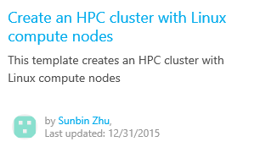
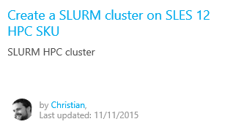
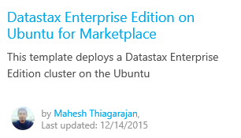
Azure Quickstart Templates
Free, open-source deployment templates
Find them on the Azure site (http://bit.ly/a4r-quickstart)
Or browse them on GitHub (http://bit.ly/a4r-github)
Notes:
You can build deployment templates of your own, or you can use ones that have already been built. An assortment of templates built by the Azure team and by others in the community can be found on the Azure Quickstart Templates Web site or on GitHub. There are templates for creating clusters of Linux VMs, deploying Redis clusters of Ubuntu VMs, deploying MySQL servers, creating Windows VMs provisioned with IIS, and a whole lot more. There is even a template that deploys Minecraft Server in an Ubuntu VM.
Using any of these templates requires nothing more than a button click. Each template comes with documentation that tells you what parameters it requires and whether the template was created by Microsoft or by someone in the community. Best of all, you can view each template’s source code, which is little more than a JSON script, and customize it to fit your needs or even build upon it to create templates of your own.
The three templates pictured here are just a few of the many dozens of templates currently available.

Slide 10
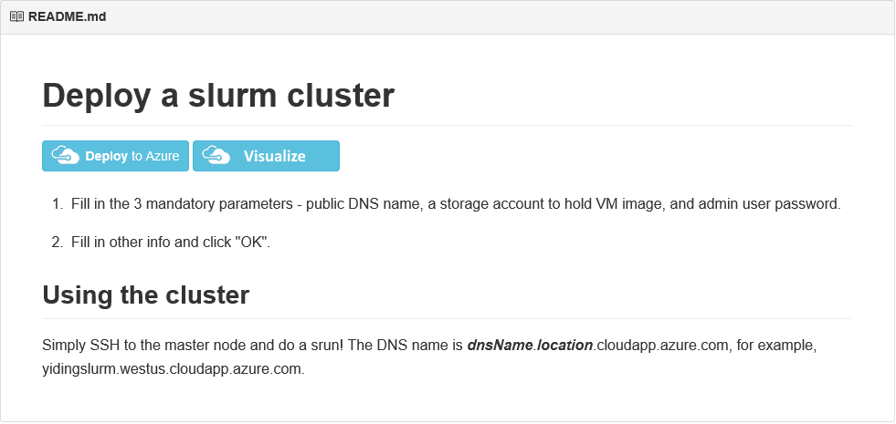
SLURM Clusters
Simple Linux Utility for Resource Management (SLURM)
Quickstart template at http://bit.ly/a4r-slurm enables easy deployment of SLURM clusters of user-specified sizes
Notes:
The Simple Linux Utility for Resource Management (SLURM), also known as the SLURM Workload Manager, is a free and open-source job scheduler for Linux that excels at distributing heavy computing workloads across clusters of machines and processors. It is used on more than half of the world's largest supercomputers and High-Performance Computing (HPC) clusters, and it enjoys widespread use in the research community for jobs that require significant CPU resources.

Slide 11
Hands-On Lab
Creating a SLURM Linux Cluster
SLURM Linux Cluster HOL.html

